Slide 1

ELIXIR-ITA: supporting the growth of bioinformatics in Italy with research, infrastructures and training

Slide 2
ELIXIR
A distributed infrastructure for life-science information
RESEARCH INFRASTRUCTURE
build a sustainable European infrastructure for biological information
collection, quality control and archiving of large amount of biological data
link the hundreds of biological databases in Europe into a larger bioinformatics infrastructure

Slide 3
ELIXIR
A distributed infrastructure for life-science information
2. TRAINING
provide training to a large and diversifying user base
develop a new generation of professionals
develop a new generation of trainers

Slide 4


Slide 5














ELIXIR-ITA: supporting the growth of bioinformatics in Italy with research, infrastructures and training

Slide 6





CNR-IBBE (G. Pesole - Head of Node)
CNR – ISA (A. Facchiano) | Università di Bari (M. Attimonelli)
CNR – ITB (L. Milanesi) | Università di Bologna (R. Casadio)
CINECA (S. Bassini) | Università di Milano (G. Pavesi)
CRS4 (G. Zanetti) | Università di Milano-Bicocca (G. Mauri
GARR (F. Ruggieri) | Università di Padova (G. Valle)
INFN (G. Maggi) | Università di "Tor Vergata" (G. Cesareni)
Sapienza Università (A. Tramontano) | Università della Tuscia (A. Valentini)

Slide 7
Head of Node: Graziano Pesole (IBBE-CNR Bari, Università di Bari)
Head of Node (HoN))
Technical coordinator (TeC )
Training coordinator (TeC )
Local Technical Coordinators (LTeCs)

Slide 8
Our main ambition is to stimulate and assist the development, rationalization and integration of bioinformatics research in Italy, and to transfer the benefits of all these activities to our European partners and in particular to other ELIXIR Nodes, towards the achievement of a pan-european bioinformatics infrastructure able to cope with the present and future challenges posed by life sciences.

Slide 9
ELIXIR-ITA training programme (late)2015/2016

Slide 10
Goals of ELIXIR- Training Italy
Develop a
programme/ infrastructure
for bioinformatics training
Visibility of ELIXIR-ITA in Europe
Support and strengthen research in bioinformatics
Form qualified instructors

Slide 11
Activities
Collaborating with ELIXIR's nodes and participating in training activities in order to bring benefits to training in Italy
Participation in grant writing
Designing, organising and running training courses in specific subject areas
Gathering of:
institutions and subject areas of greatest need for training
members that are currently delivering training initiatives
qualified instructors
Designing, organising and running Train the Trainer (TtT) events (ELIXIR-EXCELERATE)

Slide 12
Activities
Training (Italy)
EXCELERATE WP11 TtT subtask (Europe)

Slide 13

Courses 2015
Gene Expression profiling with HTS: RNA-Seq data analysis – CINECA Rome - 19-22 October 2015
Protein Networks and Systems Biology, Università di Bologna, 14-18 December 2015
High Throughput Sequencing (HTS) data analysis – Sapienza Università - 5-7 October 2015
NGS for evolutionary biologists: from basic scripting to variant calling – CINECA Rome - 23-27 November 2015
http://bioinformaticstraining.pythonanywhere.com
elixir.ita.training@gmail.com

Slide 14
Courses 2016
High Performance Molecular Dynamics@CINECA - PRACE Edition
CINECA, Bologna - 20-30 September 2016
High Performance Molecular Dynamics
CINECA, via dei Tizii 6, Rome - 5-7 April 2016
Effective academic teaching
University of Salerno, Fisciano (SA), Italy - June 15th, 2016
NGS for evolutionary biologists: from basic scripting to variant calling
Consiglio Nazionale delle Ricerche, Naples - May 2-6, 2016
RNA-seq data analysis
University of Naples Federico II, Naples - June 6-10, 2016
http://bioinformaticstraining.pythonanywhere.com
elixir.ita.training@gmail.com

Slide 15
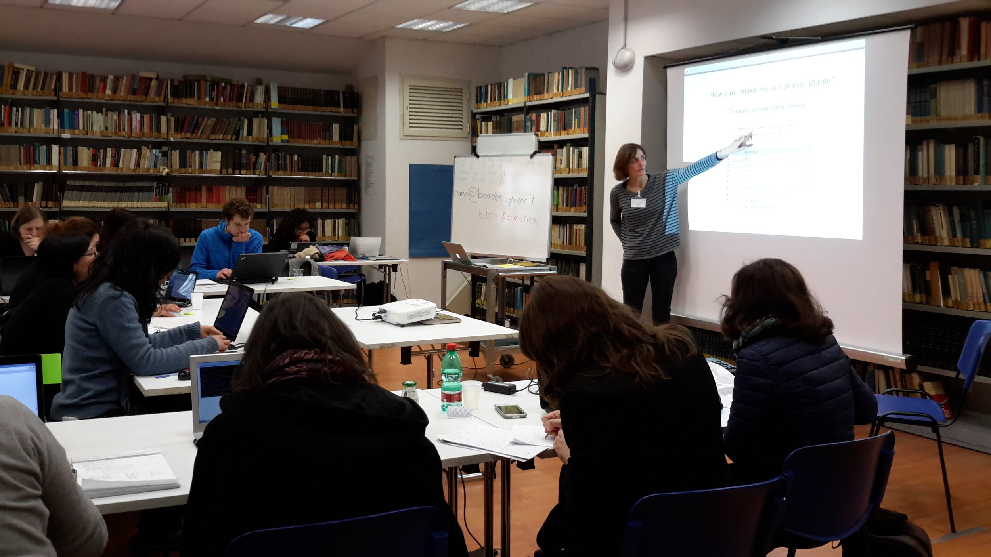
Practical Courses

Slide 16
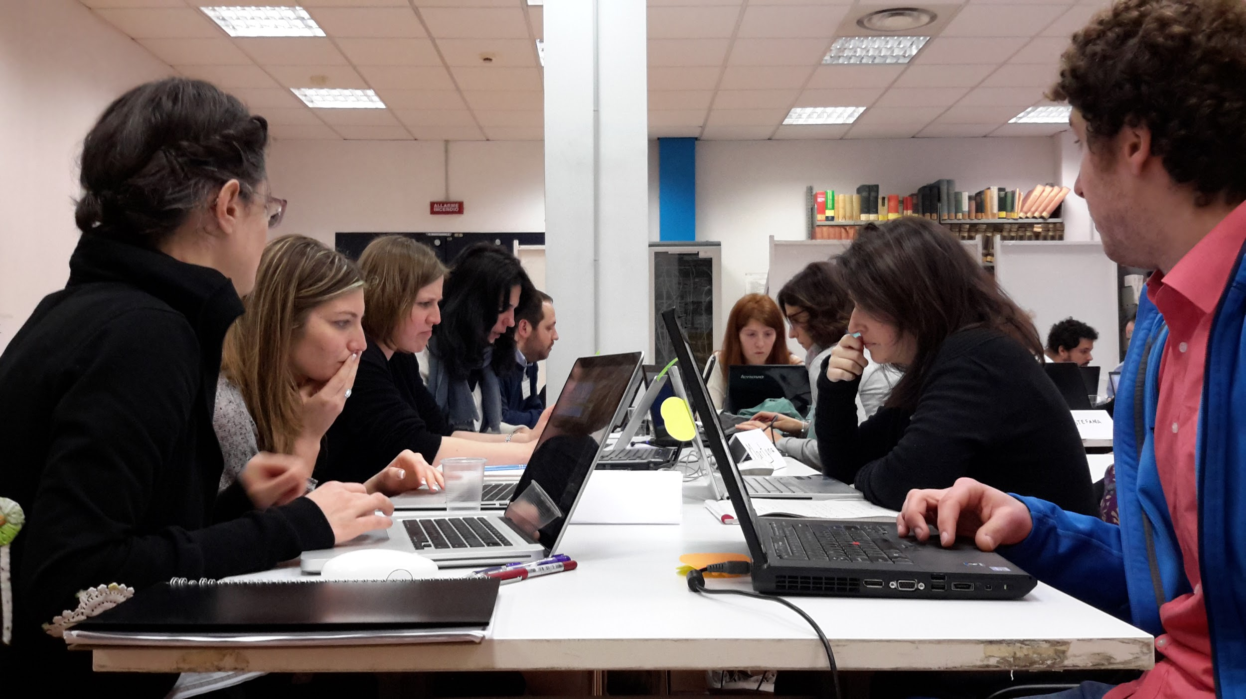
Group work and Peer-Learning

Slide 17
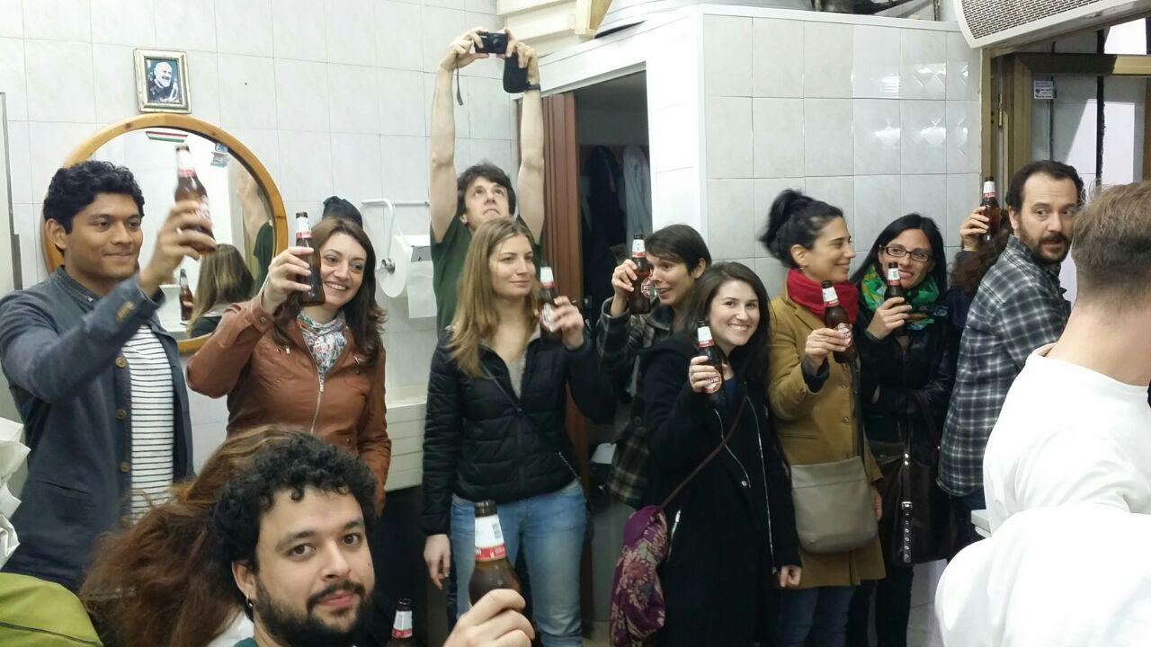
Social Activities

Slide 18
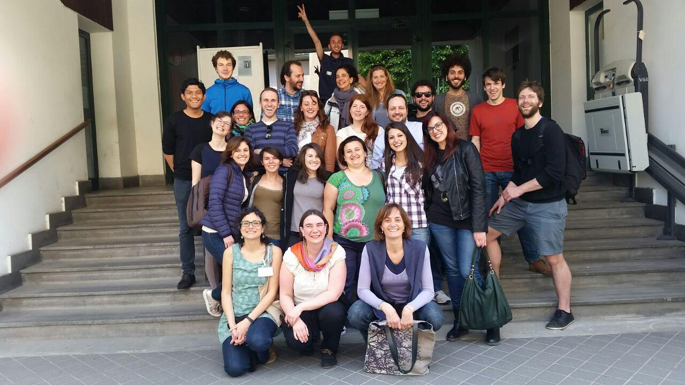
Feedbacks

Slide 19

This workshop
Elixir contribution:
10 fellowships
1 trainer

Slide 20
More on the agenda 2016
ELIXIR-ITA training courses on (suggested topics):
Biostatistics, data analysis and data representation
RNA-Seq data analysis
Variant calling data analysis
Unix/Linux and Python programming for Life Scientists – building pipelines
Protein Networks and Systems Biology
Data/Software Carpentry course on R programming
Big Data Management and analysis
NGS data processing and analysis in metagenomics

Slide 21
Activities
Training (Italy)
EXCELERATE WP11 TtT subtask (Europe)

Slide 22
EXCELERATE WP11 TtT subtask
Train the Trainers (TtT)
Survey across all ELIXIR nodes:
need in increasing training capacity
already delivering TtT initiatives
Workshop on using VMs and clouds in training
Review workshop
Dec 2015
Jan2016
Mar2016
… 2016
Workshop to review methodologies and identify effective training approaches ()
6 TtT events

Slide 23


EXCELERATE WP11 TtT subtask
Effective academic teaching
University of Salerno, Fisciano (SA), Italy - June 15th, 2016
http://bioinformaticstraining.pythonanywhere.com/course/9/

Slide 24
Thank you

